Slide 1
CPT211/2015: Demo Day
Monday, May 18 2015

Slide 2

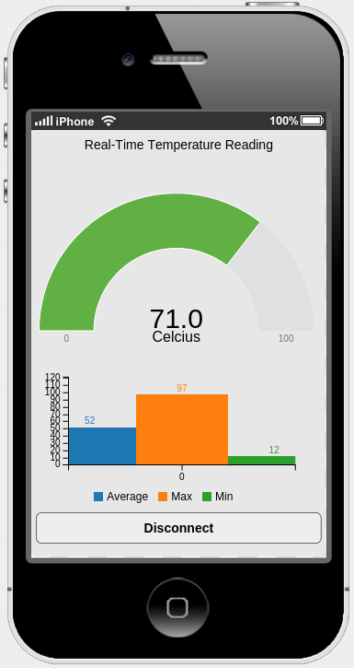
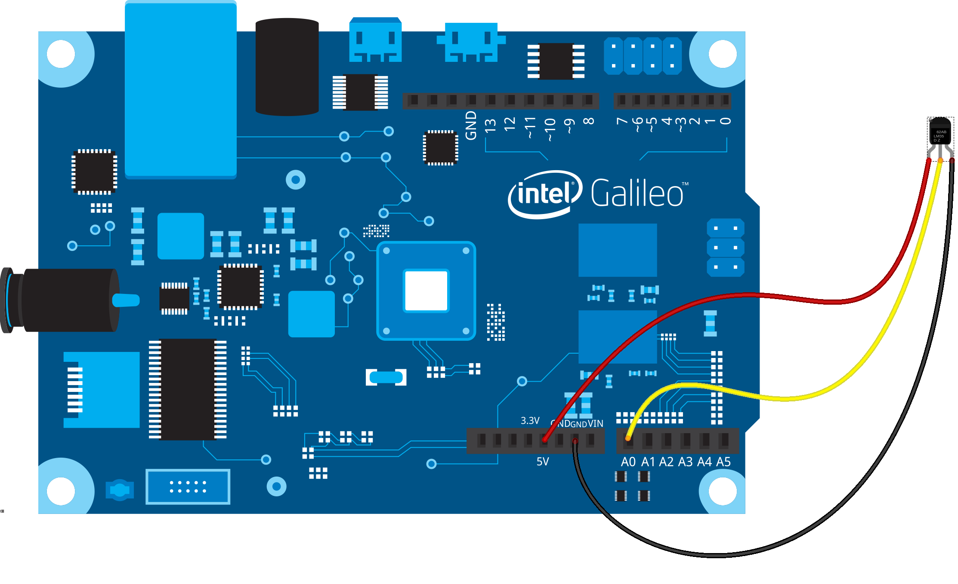
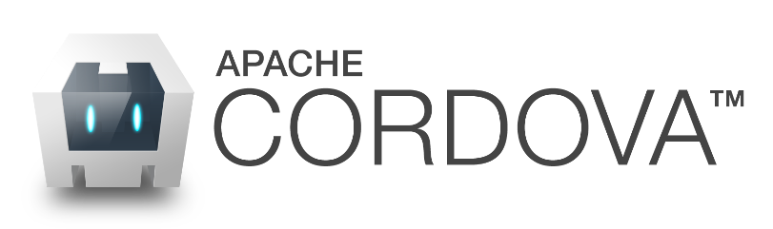





mraa library
D3.js
Express.js
C3.js

